Slide 1
LINK
GROUP
LINK
Automation Engineering (Shanghai) Co.,Ltd.
GROUP
霖和自动化工程(上海)有限公司
Training Record
Pham Tung Lam : PLC Engineer
Module Type management

Slide 2
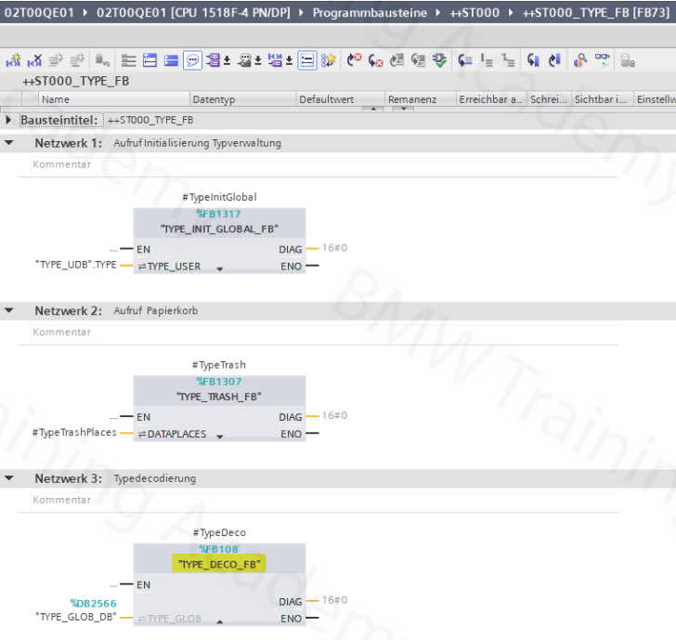
GENERAL INFORMATION
The TYPE_DECO_FB is called once in the ++ST000_TYPE_FB. The recycle bin and the initialization of the type management are also programmed here

Slide 3
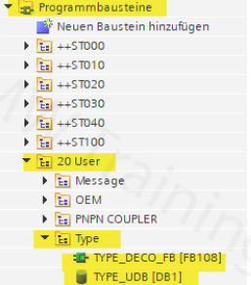
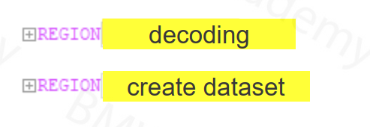
Two blocks must be adapted for the decode data and "generate" data functions: - TYPE_DECO_FB - TYPE_UDB
The data decoding and the data generation are to be implemented in the TYPE_DECO_FB. Two REGIONS are provided for this in the block:

Slide 4
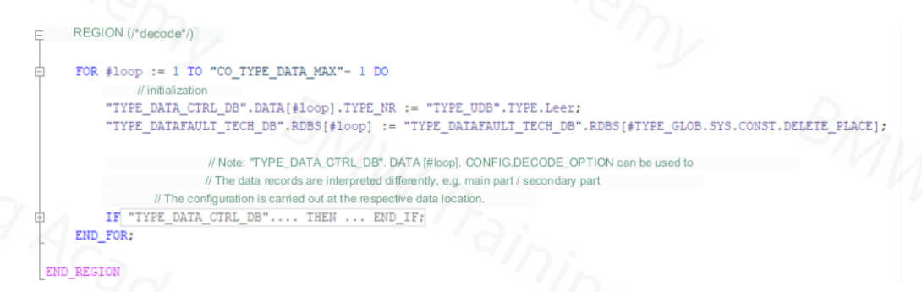
In the REGION "decoding" of the TYPE_DECO_FB, the "internal types" required for production (stored in the TYPE_UDB) are generated technology-specifically from the information in the TYPE_DATA_TECH_DB. This function is necessary in every system.

Slide 5
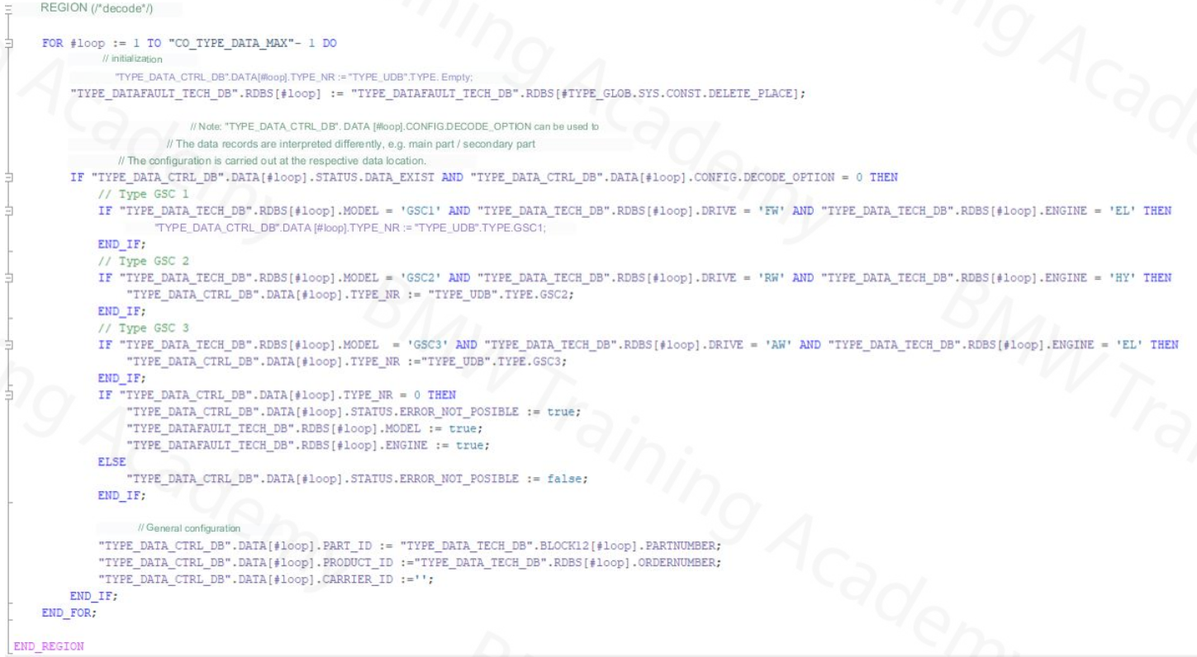

Slide 6
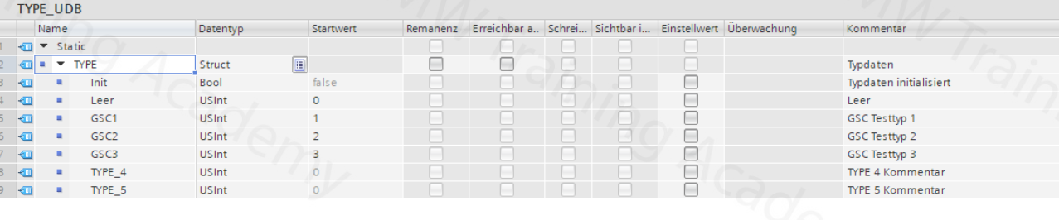
The types required for production are defined in TYPE_UDB. The TYPE_DECO_FB decodes these types and the TYPE_DATAPLACE_FB makes them available in the processing points (device, robot, etc.).

Slide 7
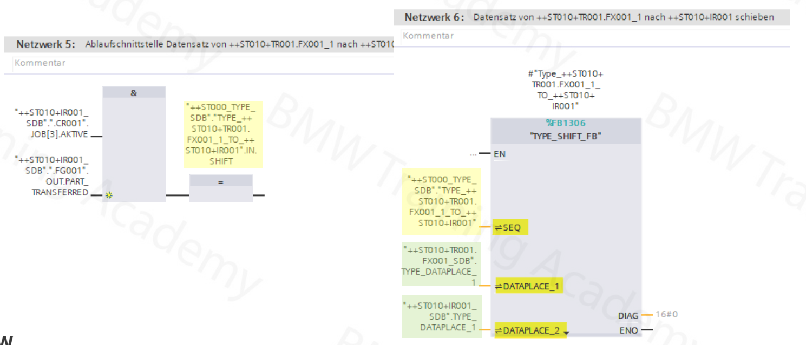
Type shifting is programmed in ++ST000_TYPE_FB at a higher level. The shift signals and calls of the TYPE_SHIFT_FB are made here for all scenarios.

Slide 9


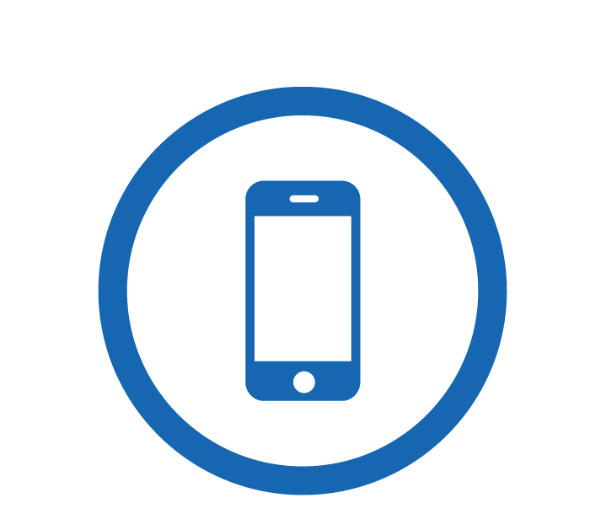
Contact Us
LINK Group Headquarter
Shanghai, China
LINK Group North China
Shenyang, China
LINK Group Europe (LKGG GmbH)
Bad Reichenhall, Germany
Enquiry
Enquiry
Enquiry
ying.liu@LKautomation.com
kimi.wang@LKautomation.com
jackey.yin@LKautomation.com
+86 021 6918 0161
+86 021 6918 0161
+86 186 2171 9367
Sales
Sales
Sales
gene.zhang@LKautomation.com
gene.zhang@LKautomation.com
andreas.reymendt@LKautomation.com
+86 136 2179 1621
+86 136 2179 1621
Address
BLDG #D,North Jiasong Road No.3570 Jiading District,Shanghai,P.R.China
Address
NO. 14 22nd Floor,NO.168-3 Harbin Road,
Shenhe District,Shenyang,Liaoning
Province,P.R.China
Address
Fischerbraeuwiese 18b,83435 Bad
Reichenhall,Bavaria,Germany

